Slide 1
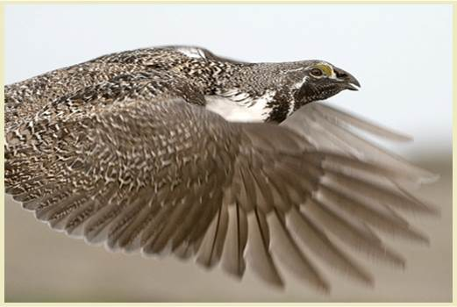
Overview of the Conservation Efforts Database
Presented by:
Kathy Hollar, US FWS
Justin Welty, USGS
Lief Wiechman, US FWS
Matt Heller, US FWS
Figure 1. Simplified portrayal of the CED structure and information flow.

Slide 2
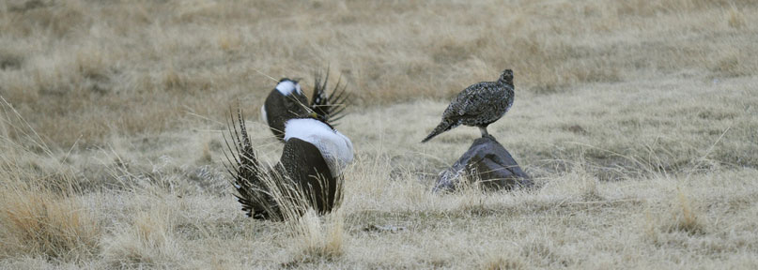
Today’s Agenda
CED Overview – Kathy Hollar
Registering Process – Kathy Hollar
Live Demo of Project Entry – Justin Welty
Plan Entry – Kathy Hollar
Batch Uploads – Matt Heller
Questions - All

Slide 3
CED Overview – What is it?
Web-based, geospatial components
Collects information on the plans and projects to conserve greater sage-grouse from 2009 to present
Allows multiple users to enter data at different scales, upload documents and spatial information, and link conservation actions to one or more threats to the species.
Conservation plans, individual projects, tabular data from large data sets, spatial data, and documentation of the data sources can all be entered in the CED
Housed on the data sharing platform, LC Map (aka ScienceBase)

Slide 4
CED Overview
Easy to use
No GIS skills are required for entering data on individual plans or projects.
USGS programmers are available to help with batch uploads of large data sets
User Guide and Help Document
Secure
Agencies/organizations establish “approving officials” to act as gatekeepers
Determine who can enter and edit data in the CED on behalf of that agency
Establish what will be “batch upload” or individual project entry
Designated “approving officials” will allow for quality control and oversight by agency partners
Transparent
Information on the CED will become part of the public record and may be publicly disclosed as part of the Service’s administrative record or in response to a request under the Freedom of Information Act (FOIA).
Viewable map of approved projects – finest scale 1” = 1 mile

Slide 5
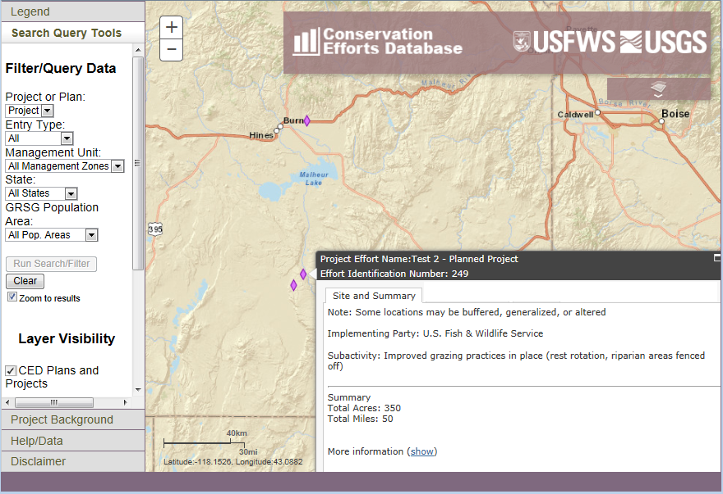
CED Overview

Slide 6
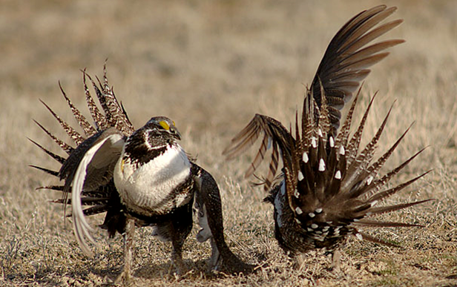
CED Overview
Each effort (project or plan) consists of six main components:
Basic project information
- Name, agency/group, status
Location information
- Easy-to-use onscreen digitizer, or upload shape files
Activity and metrics
Threats addressed
- Thirteen threats from COT Report
Upload supporting documents (optional)
- Provide context, ‘tell the story’
Implementation and
effectiveness information

Slide 7
CED Overview
How will the Service use the information in the CED?
Each plan or project entered in the CED will be linked to one or more of the following threats:
Agricultural Conversion | Free Roaming Equids | Mining | Urbanization
Conifer Encroachment | Grazing/Range Management | Noxious Weeds/Annual Grasses
Energy Development | Infrastructure | Recreation
Fire | Isolated/Small Population Size | Sagebrush Elimination
The Service will use the information in the CED to assess whether such efforts will successfully ameliorate the specific threats to each population and its’ associated Priority Areas for Conservation (PACs), as identified in the Conservation Objectives Team Report (COT report).
The CED will not collect information about the distribution or severity of threats as that information will be collected by the Service through other venues.

Slide 8
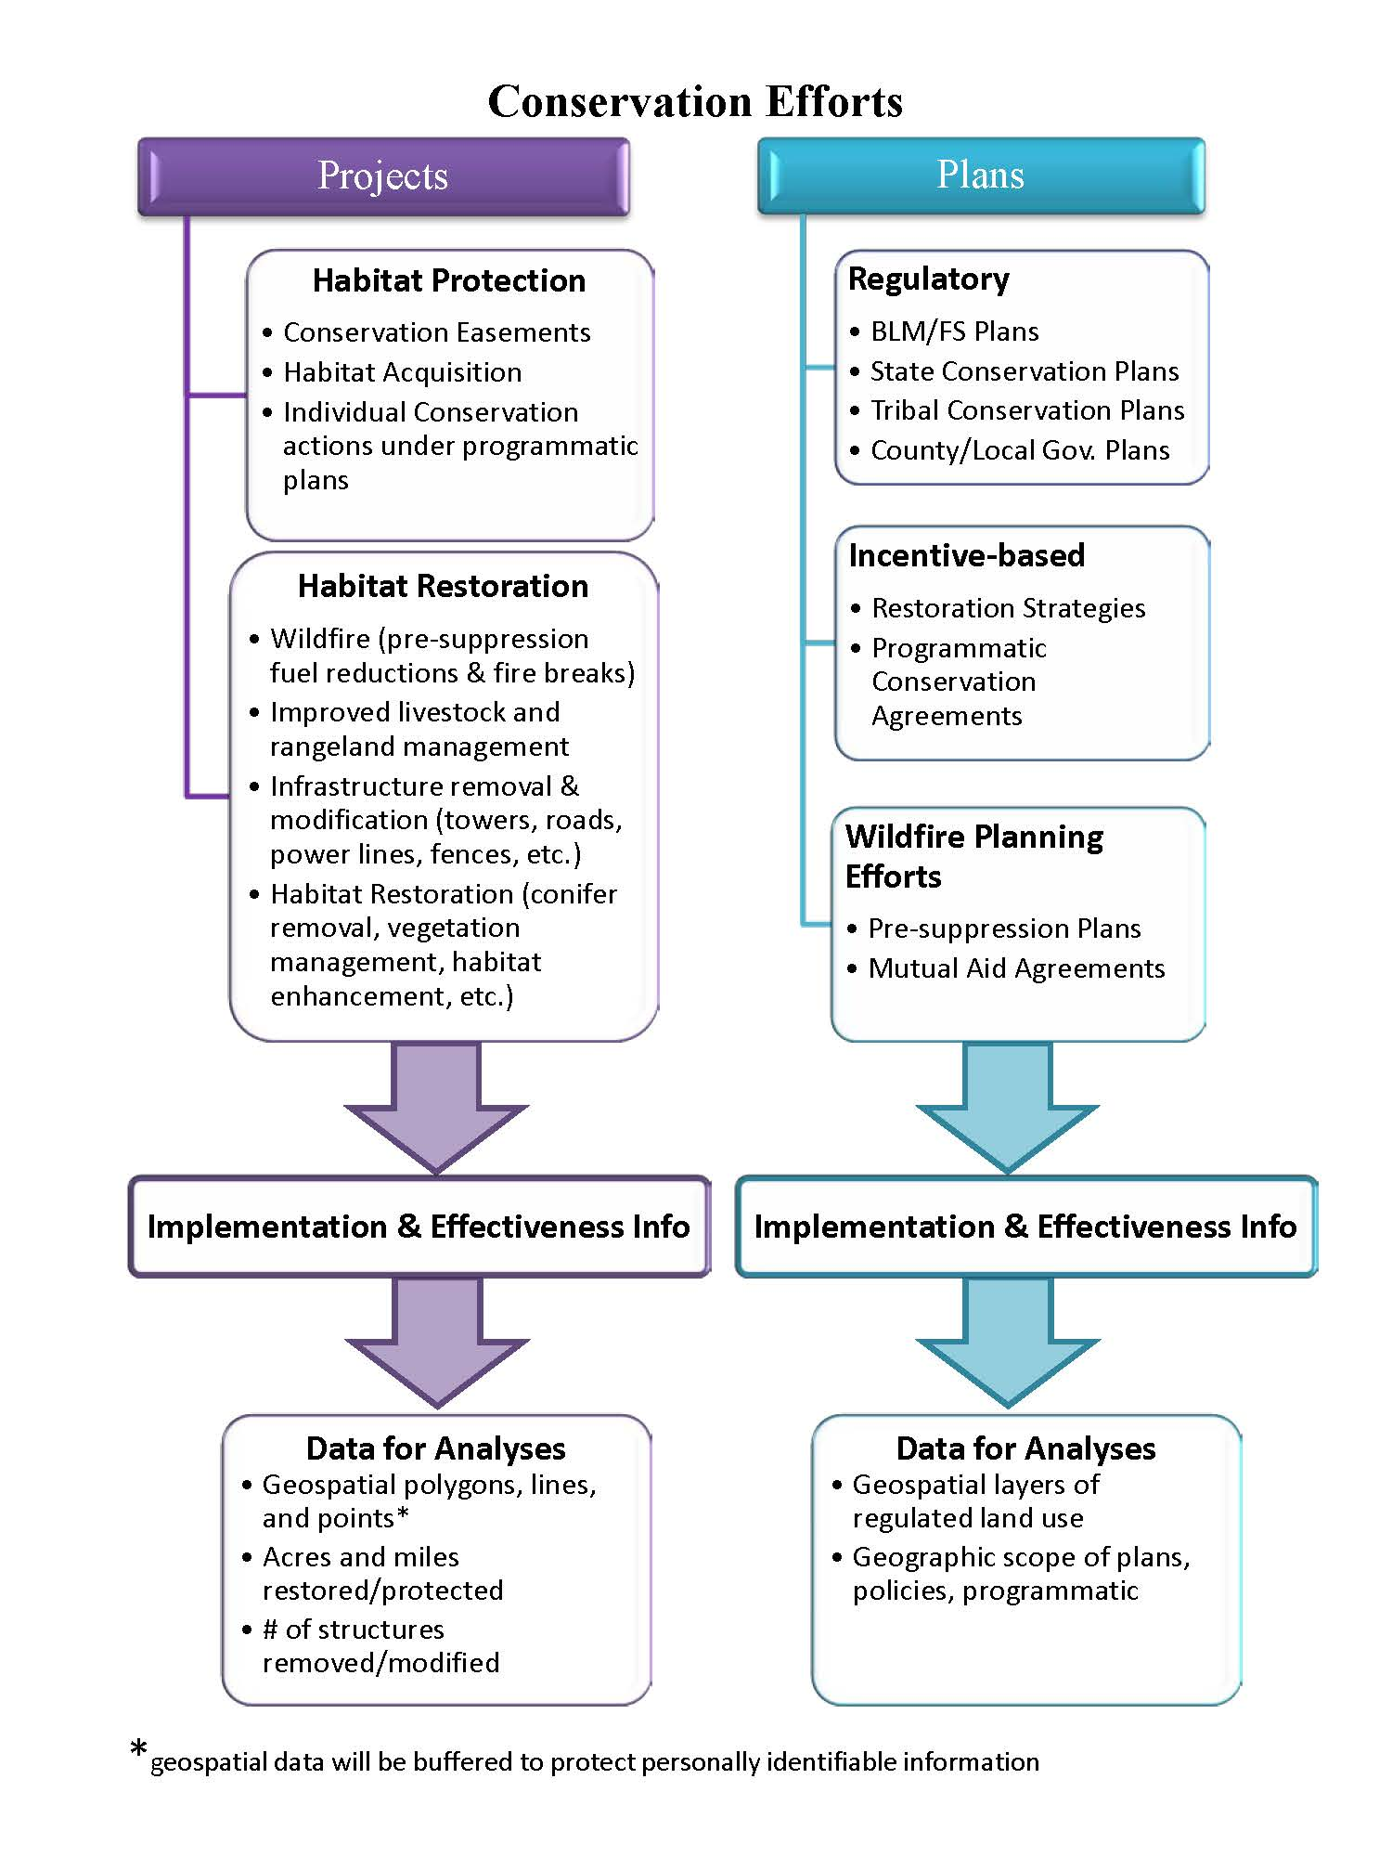

Slide 9
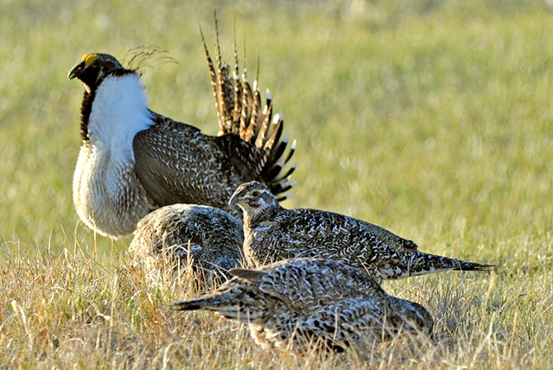
Overview Questions?
Notes:
For a long time, the sagebrush of the American west has been flyover country –
Now, there is a growing awareness that while the attention is focused on THIS bird, this bird really represents this entire ecosystem, many other species, including wildlife economically important to western states……………. a system important to human uses AND wildlife.
Our goal is the long-term conservation of sage-grouse and healthy sagebrush shrub and native perennial grass and forb communities by maintaining viable, connected, and well-distributed populations and habitats across their range as insurance against local population crashes and to speed recovery from the disturbances that will inevitably occur.
This is not an “ordinary” ESA review – and it deserves the extraordinary effort that the Service has invested in it.
First of all, we are working as hard as we can to get as much conservation on the ground so that when we do have to make the call, we’ll know we’ve done everything possible to make a listing unnecessary.
We’ve made an unprecedented investment – in terms of staff, resources and leadership, in building relationships and helping our federal, state and NGO partners focus on the things that will mean most to sage-grouse and the other species it represents.
We’ve had to innovate – for example revamping our Conservation Efforts Database to spatially locate the myriad of conservation actions that have occurred. We’ve contracted with WAFWA to work with the Invasives Working Group to synthesize fire and fuels management programs at the private, local, state, and federal agency scales to help build a series of recommendations that may inform future policy and allocation decisions.
Our decision will ultimately be based on scientific data, management commitments and conservation actions - a mountain of data new information that we will ask our partners to start sending us this month. We are committed to building the most transparent, thorough and scientifically defensible status review in the agency’s history.
We’re pulling out all the stops because it is that important, not only to sage-grouse but to a myriad of other wildlife species and to the future of species conservation.
Because what happens with sage-grouse will affect how conservation is done in the West for a generation OR MORE.
It will affect how the ESA moves into the future – will it remain one of the strongest conservation statutes ever established?
Get it wrong, and we’ll remain captive to the same toxic politics and zero-sum rhetoric that has made our work so challenging.
Get it right, and we’ll build trust with states, with conservation partners, with private landowners.
Get it right, and we’ll achieve conservation on a scale rarely seen since the days of TR Roosevelt.
So this is about more than just the sage-grouse. It’s about a uniquely American landscape – full of hard-working ranchers, world-class big game and the wide-open spaces that are so much a part of our American identity.
It’s also about reaffirming a distinctly American value – that diverse interests with sometimes competing goals can and should work together and find solutions that benefit the common good.
And it’s about debunking the myth that the ESA is broken – If we can prove that it can work on a landscape-scale in tough circumstances like these, it will benefit all of our work in the coming years and beyond.

Slide 10
CED Registration Process
Pre-Registration – Agency Control
Participating Agencies/Organization determine
What info they want to provide
How they want to provide it – Batch Upload or Individual Project Entry
Who will provide the info
Who will run QA/QC on the info
Who can modify CED records
Individual Registration
User name, Password, generate link to activate account
Select Agency, Field Office, Approving Official

Slide 11
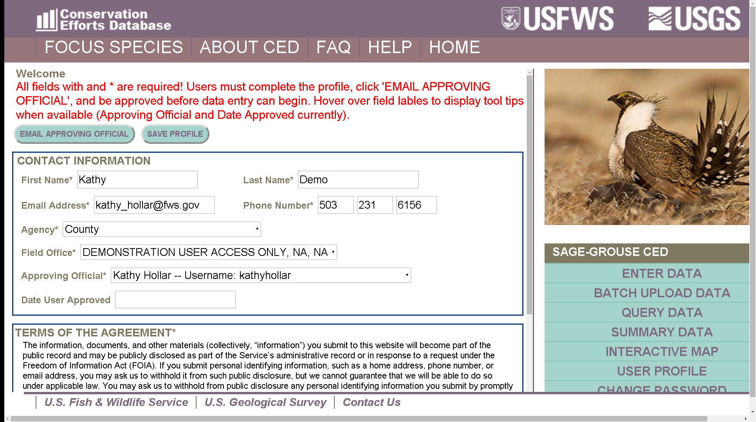
CED Registration Process

Slide 12
Registration Questions?
Notes:
For a long time, the sagebrush of the American west has been flyover country –
Now, there is a growing awareness that while the attention is focused on THIS bird, this bird really represents this entire ecosystem, many other species, including wildlife economically important to western states……………. a system important to human uses AND wildlife.
Our goal is the long-term conservation of sage-grouse and healthy sagebrush shrub and native perennial grass and forb communities by maintaining viable, connected, and well-distributed populations and habitats across their range as insurance against local population crashes and to speed recovery from the disturbances that will inevitably occur.
This is not an “ordinary” ESA review – and it deserves the extraordinary effort that the Service has invested in it.
First of all, we are working as hard as we can to get as much conservation on the ground so that when we do have to make the call, we’ll know we’ve done everything possible to make a listing unnecessary.
We’ve made an unprecedented investment – in terms of staff, resources and leadership, in building relationships and helping our federal, state and NGO partners focus on the things that will mean most to sage-grouse and the other species it represents.
We’ve had to innovate – for example revamping our Conservation Efforts Database to spatially locate the myriad of conservation actions that have occurred. We’ve contracted with WAFWA to work with the Invasives Working Group to synthesize fire and fuels management programs at the private, local, state, and federal agency scales to help build a series of recommendations that may inform future policy and allocation decisions.
Our decision will ultimately be based on scientific data, management commitments and conservation actions - a mountain of data new information that we will ask our partners to start sending us this month. We are committed to building the most transparent, thorough and scientifically defensible status review in the agency’s history.
We’re pulling out all the stops because it is that important, not only to sage-grouse but to a myriad of other wildlife species and to the future of species conservation.
Because what happens with sage-grouse will affect how conservation is done in the West for a generation OR MORE.
It will affect how the ESA moves into the future – will it remain one of the strongest conservation statutes ever established?
Get it wrong, and we’ll remain captive to the same toxic politics and zero-sum rhetoric that has made our work so challenging.
Get it right, and we’ll build trust with states, with conservation partners, with private landowners.
Get it right, and we’ll achieve conservation on a scale rarely seen since the days of TR Roosevelt.
So this is about more than just the sage-grouse. It’s about a uniquely American landscape – full of hard-working ranchers, world-class big game and the wide-open spaces that are so much a part of our American identity.
It’s also about reaffirming a distinctly American value – that diverse interests with sometimes competing goals can and should work together and find solutions that benefit the common good.
And it’s about debunking the myth that the ESA is broken – If we can prove that it can work on a landscape-scale in tough circumstances like these, it will benefit all of our work in the coming years and beyond.

Slide 13
CED Plan Information
CED Plan Efforts
Regulatory Plans
Incentive-based Plans
Fire Suppression Plans

Slide 14
CED Plan Information
Request: Threat-specific records for each
threat addressed in regulatory plans
Summarize how the plan addresses the suggested Conservation Objective listed in the COT Report
Summarize policies/regulations/ordinances to prevent/minimize/ameliorate the threat
Upload relevant documents supporting the summary information
Summarize funding source(s) and funding plan
Describe any obstacles to full implementation of the plan
Describe any successes in implementing the plan
Describe implementation plan for the next five years
Describe plans for monitoring effectiveness
Include any additional information needed to describe the plan

Slide 15
Plan Information Questions?
Notes:
For a long time, the sagebrush of the American west has been flyover country –
Now, there is a growing awareness that while the attention is focused on THIS bird, this bird really represents this entire ecosystem, many other species, including wildlife economically important to western states……………. a system important to human uses AND wildlife.
Our goal is the long-term conservation of sage-grouse and healthy sagebrush shrub and native perennial grass and forb communities by maintaining viable, connected, and well-distributed populations and habitats across their range as insurance against local population crashes and to speed recovery from the disturbances that will inevitably occur.
This is not an “ordinary” ESA review – and it deserves the extraordinary effort that the Service has invested in it.
First of all, we are working as hard as we can to get as much conservation on the ground so that when we do have to make the call, we’ll know we’ve done everything possible to make a listing unnecessary.
We’ve made an unprecedented investment – in terms of staff, resources and leadership, in building relationships and helping our federal, state and NGO partners focus on the things that will mean most to sage-grouse and the other species it represents.
We’ve had to innovate – for example revamping our Conservation Efforts Database to spatially locate the myriad of conservation actions that have occurred. We’ve contracted with WAFWA to work with the Invasives Working Group to synthesize fire and fuels management programs at the private, local, state, and federal agency scales to help build a series of recommendations that may inform future policy and allocation decisions.
Our decision will ultimately be based on scientific data, management commitments and conservation actions - a mountain of data new information that we will ask our partners to start sending us this month. We are committed to building the most transparent, thorough and scientifically defensible status review in the agency’s history.
We’re pulling out all the stops because it is that important, not only to sage-grouse but to a myriad of other wildlife species and to the future of species conservation.
Because what happens with sage-grouse will affect how conservation is done in the West for a generation OR MORE.
It will affect how the ESA moves into the future – will it remain one of the strongest conservation statutes ever established?
Get it wrong, and we’ll remain captive to the same toxic politics and zero-sum rhetoric that has made our work so challenging.
Get it right, and we’ll build trust with states, with conservation partners, with private landowners.
Get it right, and we’ll achieve conservation on a scale rarely seen since the days of TR Roosevelt.
So this is about more than just the sage-grouse. It’s about a uniquely American landscape – full of hard-working ranchers, world-class big game and the wide-open spaces that are so much a part of our American identity.
It’s also about reaffirming a distinctly American value – that diverse interests with sometimes competing goals can and should work together and find solutions that benefit the common good.
And it’s about debunking the myth that the ESA is broken – If we can prove that it can work on a landscape-scale in tough circumstances like these, it will benefit all of our work in the coming years and beyond.

